Slide 1
VISUALIZATION TOOL FOR DIVERSITY SHOWCASE
Presented by:
VBIT-B

Slide 2
PURPOSE MAKES IT IMPORTANT
Acknowledgement is a simple gesture for a powerful result. Yet women and acknowledgement don’t go hand in hand. Why are women kept away from the basic celebration of their effort? – “The Acknowledgement”.

Slide 3
WHY IS THIS TOPIC NEED TO BE ADDERSSED:
Every effort addressed, comes up with new enthusiasm in the work holders. Women since the ancient times are deprived of this privilege of acknowledgement. Voicing out this unnoticed dominance of crediting men over women has become essential since these credits have become the criteria to avail new opportunities such as positions in Research centers, Educational institutions etc.
In a recent study by the University of Delaware, researchers found that men are more likely to be given credit for their ideas and therefore more likely to be selected for leadership roles than women.

Slide 4
Acknowledgement of effort is their right
Inspire young girls to contribute to society
Opportunities in the field of contribution
NEED FOR ADDRESSING WOMEN CONTRIBUTION
Inspire young girls to aspire big
Increases the value of opinion of women in society
Serves as Historical evidence for women’s knowledge and strength
Importance of women in the field is known to everyone
Passes on the information to the next generation

Slide 5
IDEA BEHIND:
The project mainly shows the comparative dominance of the credits given to men over women in the domain of contributions. It is a visual representation of unconscious supress of women contributions in different fields of society such as: Entertainment, Medicine, Arts, Education, STEM, Culinary, etc.

Slide 6
CHALLENGES :
Credit deprival of women
Need for acknowledgement of women contribution
Threats if we don’t address women acknowledgements
No. of men and women contributions acknowledged
Data visualization of contributions made

Slide 7
What is our Idea of understanding?
Detailed analysis of contributions mentioned in WikiPedia
Extraction and combining of multiple datasets as CSV files
Visualization of data using Power BI

Slide 8



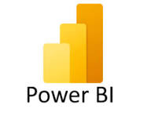
TECHNOLOGY STACK:
Data Storage and Knowledge Base:
Query Languages
SPARQL
Data Visualization
Power BI
Data Analysis and Spreadsheet Software
Microsoft Excel
Wikidata

Slide 9
KEY FEATURES OF OUR TOOL

Slide 10
Highlighting Noteworthy Women
Showcases information on remarkable women who have made significant contributions in various fields and also includes links to their respective Wikipedia pages sourced from the comprehensive Wikidata datasets.
Gender-Based Comparison
Compares and contrasts the representation of individuals recognized for their accomplishments, categorizing them by gender (male/female). This insightful analysis provides a clear overview of gender diversity in notable mentions in Wikipedia.
Interactive Wikidata Access
Enables users to explore the rich Wikidata datasets in an interactive manner. This tool offers a user-friendly interface, allowing easy navigation and exploration of information related to accomplished individuals.

Slide 11
Dynamic and Adaptable
Stays up-to-date with changes and updates in the Wikidata datasets. The tool's flexibility allows for seamless modifications, ensuring that users can always access the latest information on noteworthy individuals and their contributions.
Facilitating Wikipedia Editing
Streamline the analysis of women's contributions across diverse fields, providing Wikipedia editors with a comprehensive resource to easily access and evaluate notable individuals and their achievements

Slide 12
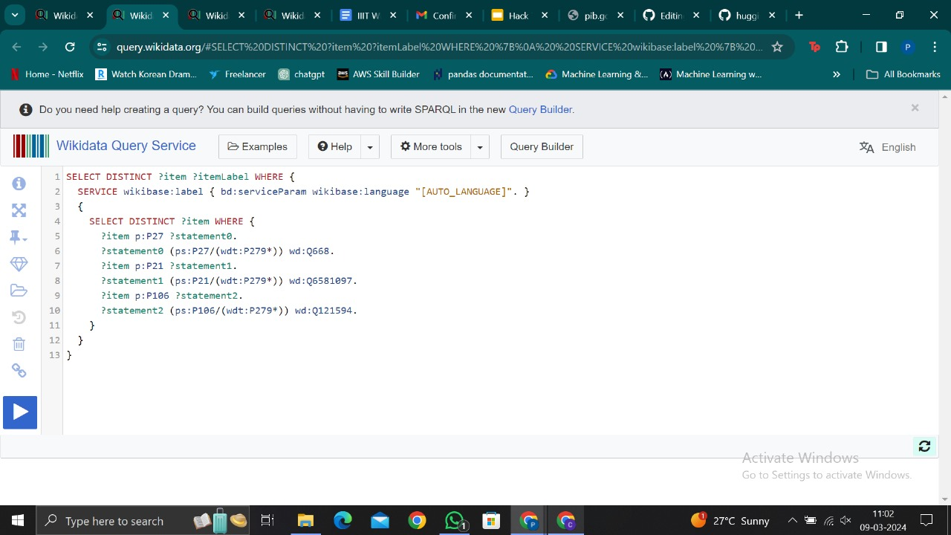
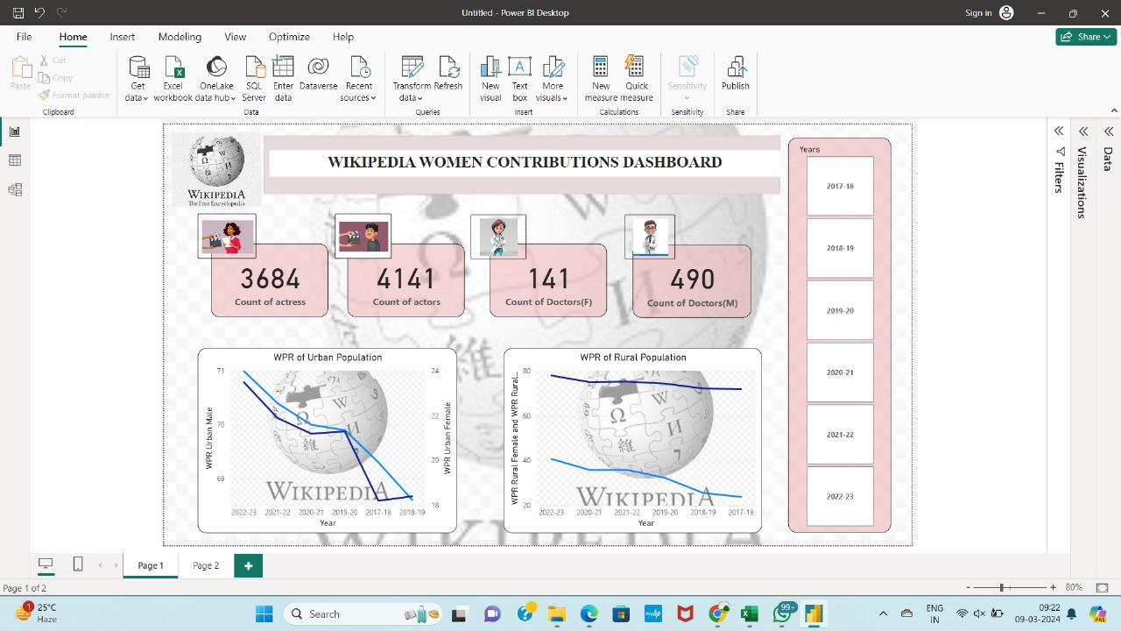
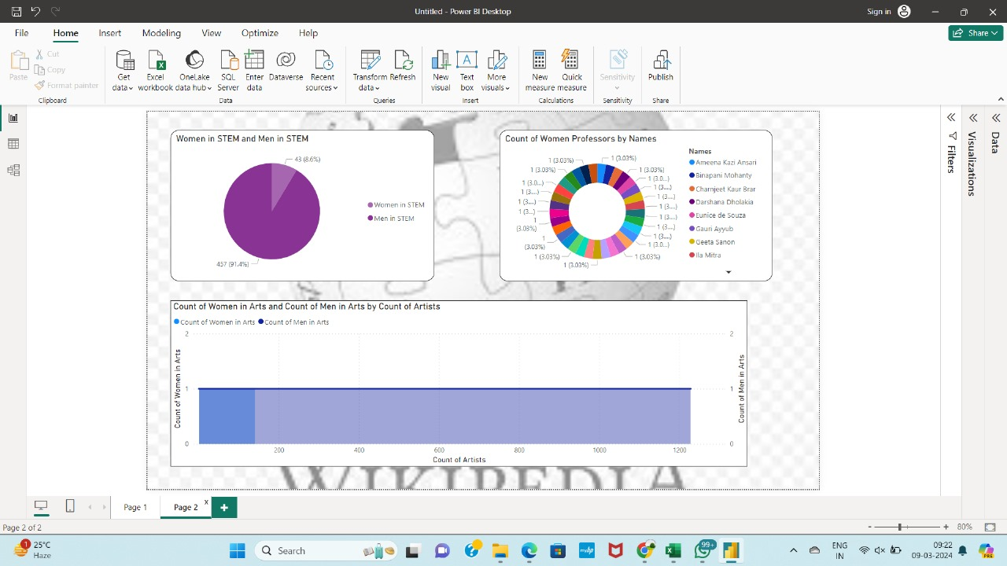

Slide 13
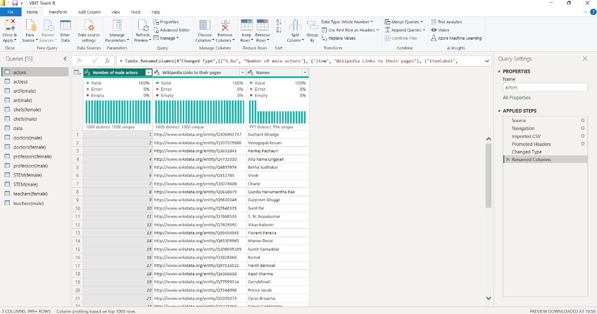
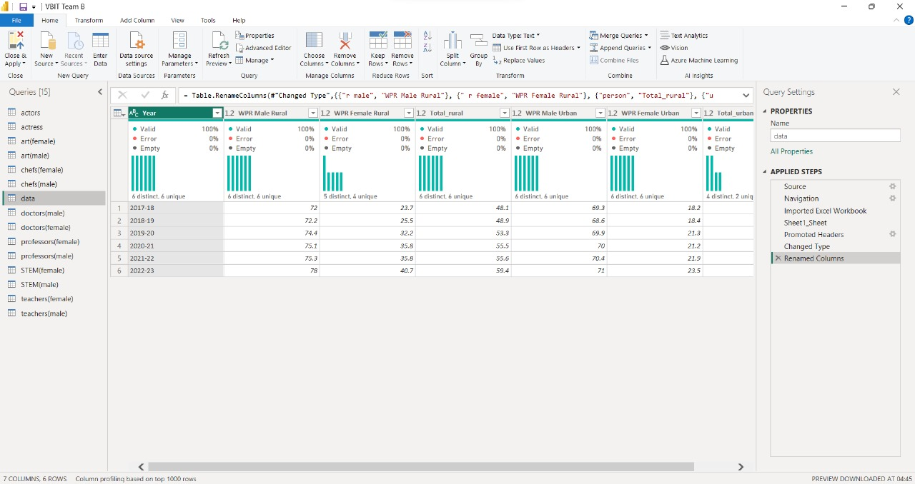
https://pib.gov.in/PressReleaseIframePage.aspx?PRID=1966154

Slide 14
FUTURE SCOPE
Temporal Evolution:
Introduce a timeline or historical evolution feature, allowing users to observe changes in women's contributions over time. This could include tracking progress, highlighting key milestones, and identifying trends.

Slide 15
THANK YOU

